Slide 1



Doctor’s assistant
Transforming the healthcare landscape through advanced Al automation, enhancing patient care, and streamlining medical processes for better outcomes.

Slide 2
doctor’s assistant solution
efficient case documentation
patient data retrieval
instant patient history access
workload reduction
faster patient care
enhanced efficiency
workload reduction

Slide 3
Key components of system
architecture
Front end development
backend
framework
database
management
system interaction flow
visual representation
of interactions
between doctors,AI,database
,and API
utilize HTML and
CSS for an intutive user interface
for doctors
employs flask to manage API
request and data processing
uses mongoDB to securly store and manage patient records

Slide 4
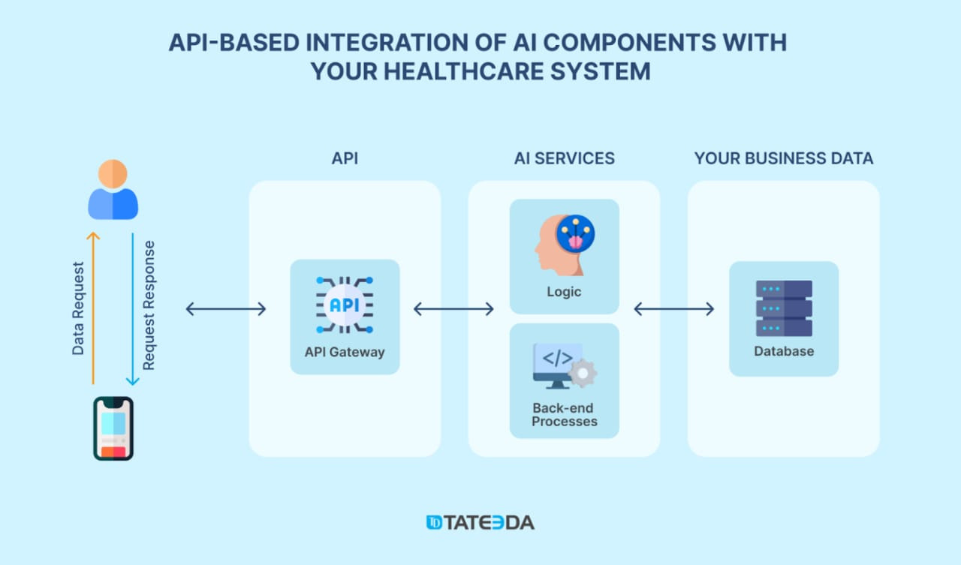

Workflow steps

Slide 5
solution outline
1. Doctor logs into the system.
2. Searches for a patient using ID or name.
3. AI fetches patient details and answers queries.
4. Doctor updates notes, diagnoses, and prescriptions.
5. AI saves updated data back to MongoDB.

Slide 6

DATABASE
DATABASE MODEL--
MONGODB
IMPLIMENTATION --
FORMAT USED IN DATABASE IS --
PATIENT ID:
NAME :
AGE:
MEDICAL HISTROY:
CURRENT MEDICATIONS:

Slide 7


Thank You!

